Slide 1
Working together to support transitions of children and young people in and from care
Anne Edwards
Professor Emerita, University of Oxford Department of Education

Slide 2
The Rees Centre
“We aim to improve the education, wellbeing and life outcomes of those who are, or have been supported by children’s social care services, with a focus on children in need (including those in care), adoptive and special guardianship families and care experienced adults.”

Slide 3
Overview
The challenges of transitions for children
Building relationships in transitions in care
Creating developmental transitions
Implications for practice

Slide 4
A Vygotskian view of the developing child
Learning precedes development
The learning child propels herself forward drawing on the resources that are available to her
She is in control of her learning
She acts in and on her environment
The adult’s role is to provide resources and encourage the unfolding of the child’s agency
As the child moves between settings and meets new demands she can experience crises
These transitions and crises are springboards for development
Key question today – how can we ensure that transitions are developmental and not detrimental?

Slide 5
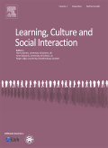
Motive orientation, new demands in practices and development
‘Children [may] acquire new motives as they anticipate or enter a new practice These new motives may be contradictory to earlier leading motives and the child’s motive orientation and competences have to be restructured.’
(Hedegaard & Edwards, 2014: 186)

Slide 6
Why transitions are so difficult
Motive orientation – we orient towards what we see as important
When we move from one setting or practice to another we need to orient towards what is important in the new setting. This is one of the ways we learn and develop
Two people can look at the same thing – like an evening meal– and orient to different aspects of it – Food makes me feel nervous…. Sitting and talking about the day is important
Children and young people may need help in re-orienting to what matters in the new setting and the setting may also need to adjust

Slide 7
Transitions in childhood and adolescence
From home to pre-school; pre-school to school; elementary to high school; high school to college or work
In adolescence - sexual development; creating an identity and shaping their future selves – a turbulent time
Ideally, we change as we move between environments and the environment changes as we act in and on the environment. Beach (1999) called this process “developmental coupling”
Most transitions are “consequential” (Beach, 1999), involving some development
When a child enters a new placement, the extent to which it responds to the child, i.e. developmental coupling happens, is crucial

Slide 8
Consequential transitions (Beach 1999)
Consequential transitions involve a change in the relationship between a person and the activities in which they engage – there are consequences for the person (and the activity)
Four types of consequential transition: lateral; collateral; encompassing; mediational
Moving into a new care setting sounds as if it might be a straightforward lateral transition; but it is probably closer to a mediational transition.
A mediational transition – where help is given to ease a transition.
Mediation can assist with developmental coupling – mutual accommodation

Slide 9
Being in care and educational outcomes (International systematic review 2015)
Children in care more likely than the general population to be unemployed, have mental health problems, lag behind on educational outcomes etc.
But being in care is not necessarily detrimental
Emphasised: caregiver sensitivity and attunement; and developing relationships with caregivers and friends
Developing relationships helps caregivers to understand the causes of a child’s behaviour
Relationships can mediate the transitions. We need to place children’s relationships at the heart of all we do – listen to and empower the child or young person
(O’Higgens, Sebba & Luke, 2015)

Slide 10
“It is not just about friendliness”
Chambers et al. (2020) – elicited advice from foster care alumni - for children, foster carers and professionals involved in placements.
Involve children and young people in placement decisions
Children should “hang on in there”
Children should not get too attached
Give children time to orient towards what is expected
Help them feel safe when expressing emotions
“It is about establishing a bond, a relational bond of trust with a child”
Key issues
The agency of the child
The emotional aspects of transitions into new placements (trauma and loss)
The dimensions of care: distance and love
A relational bond of trust (is key to developmental coupling)

Slide 11
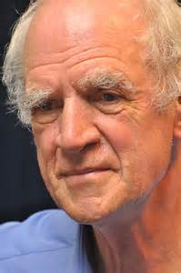
Charles Taylor (1977) We are agentic to the extent that we not only set our goals, but also to the extent that we can evaluate whether we have reached them.

Slide 12
Three concepts for building a relational bond of trust
Unpacking ‘trust’ with the aim that the child’s agency can unfold as they learn
Concept 1: Relational Expertise – is the capacity to elicit the motive orientations of another and to be clear to them about what motivates you
Concept 2: Common Knowledge- consists of each others motive orientations – what matters to each person. Building common knowledge takes time
Common knowledge then mediates the joint unfolding of concept 3 -Relational Agency

Slide 13
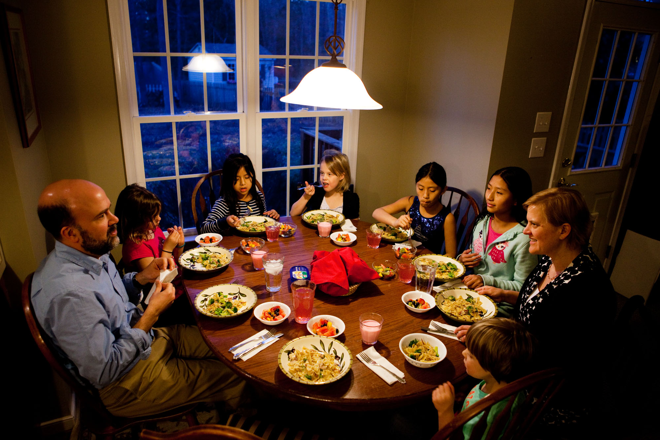
Wanting to include the young person in family life
Foster parent
Common
knowledge
(knowledge of each other’s motives)
Food makes me
nervous
Talking about the day
over the evening meal
Young
person

Slide 14
Being firm but fair to create a safe environment
Foster parent
Common
knowledge
(knowledge of each other’s motives)
Not trusting adults
Friends are important
Staying out late with
friends
Young
person

Slide 15
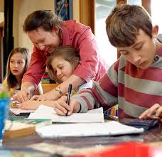
Foster parent
Work slowly to
build trust
Common
knowledge
(knowledge of each other’s motives)
Teachers don’t
understand
Child
The exams are
coming up
Settling in school
Teacher

Slide 16
Three Gardening Tools- growing a relational bond of trust
Relational expertise: involves recognising the standpoints and motive orientations of others.
Common knowledge consists of what matters to each person (their motive orientations). It becomes a resource to be used when working relationally. It can mediate transitions.
Relational agency can help sustain and grow the agency of a child or young person.

Slide 17
Why is relational agency important?
It is evidence of a “relational bond of trust”
It gradually supports the development of agency and
responsibility
It is based in efforts at mutual understanding where
the child or young person and their motive orientations (and histories) are taken seriously
Over time the adult’s role reduces – avoids dependency

Slide 18
Reflection
‘ The emotional experience (perezhivanie) arising from any situation or from any aspect of his environment, determines what kind of influence this situation or this environment will have on the child. Therefore it is not any of the factors themselves […] which determines how they will influence the future course of his development, but the same factors refracted through the prism of the child’s emotional experience’
Vygotsky (1994, p. 339)

Slide 19
Implications for carers and practitioners
Relational expertise, building common knowledge and unfolding relational agency can be learnt by foster carers and practitioners
What are the child’s motive orientations – why are they orienting in this way?
How do you learn about the origins of their current motive orientations?
What are they interpreting as the demands in the setting?
To what extent is relational agency enabling the child?

